Slide 1
Data mainig
Student Name: Saif Kamal Salim Haddad.
Student Id: 21110214.
Section number: Section (2).

Slide 2

Overview
Historical background.
Theoretical background.
Tools.

Slide 3
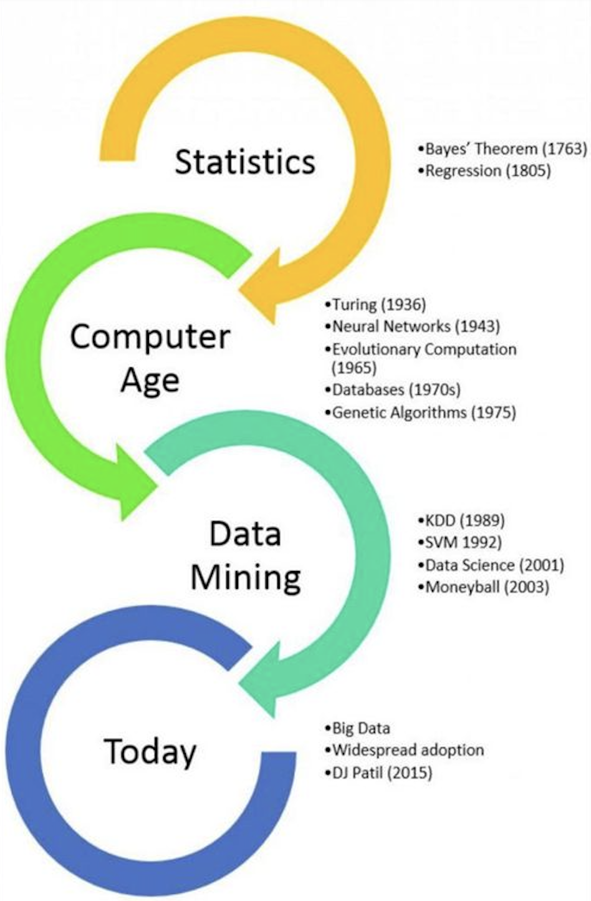
Historical background

Slide 4
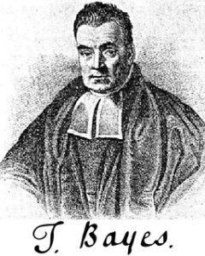
Statistics (Theoretical science) 1600 - 1950
This period was the birth of the theoretical models that guide the experiments.
Such as:
1- Bayes theorem 1763: (Suanfazu et al., 2021) (Exastax, 2017) (bootcamp.rutgers, 2021)
- It was formulated by Thomas Bayes and this paper was published after he died.
- This theorem connects present probability to previous probability.
- It enables a good understanding of complicated things based on estimated probabilities,

Slide 5
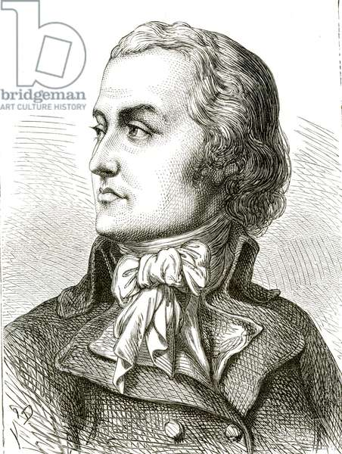
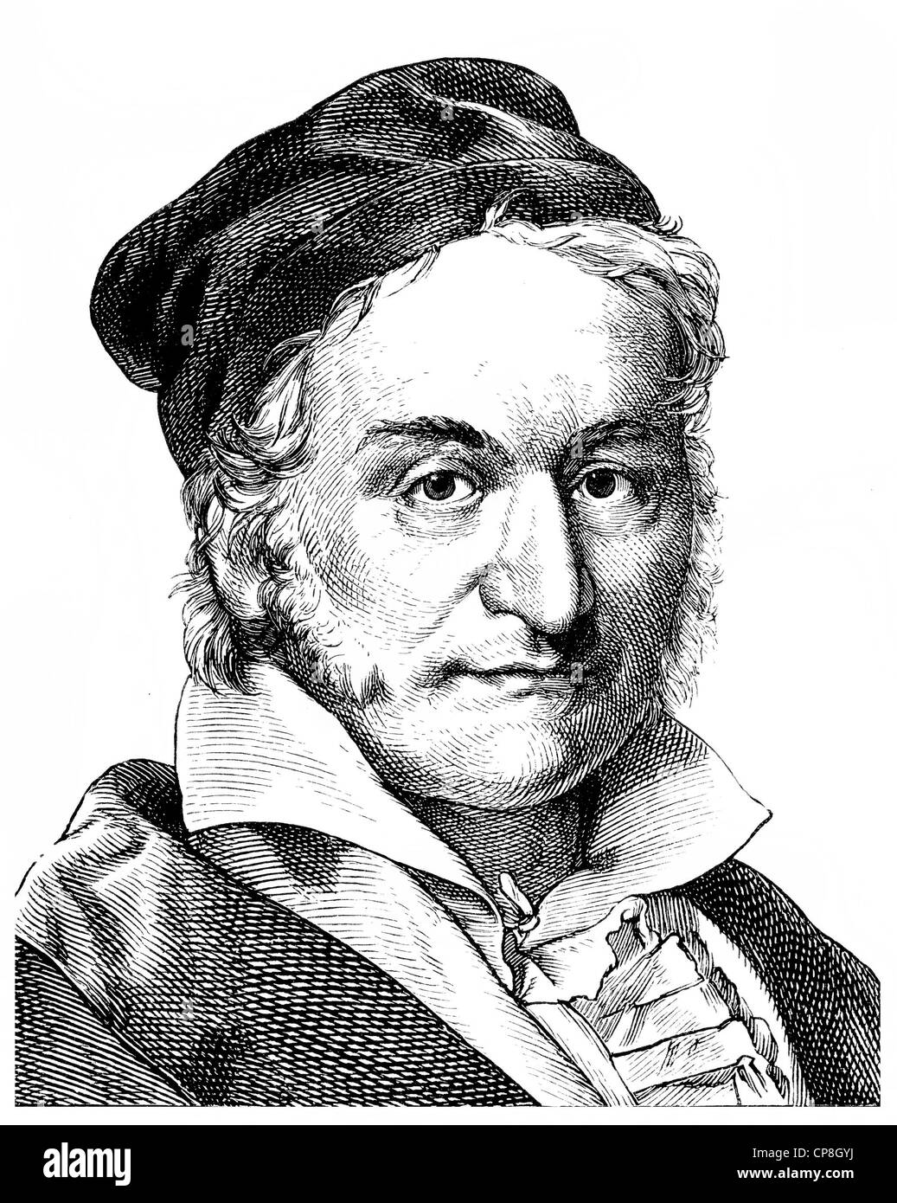
Statistics (Theoretical science) 1600 - 1950
2- Regression analysis 1805:(Suanfazu et al., 2021) (Exastax, 2017) (bootcamp.rutgers, 2021)
- Adrien-Marie Legendre and Carl Friedrich Gauss were the first two people who used regression to calculate the orbits of bodies (planets and comets) around the Sun.
- Regression analysis aims to identify the relationships between variables.
- The technique employed in this case is the least squares approach.
Adrien
Carl

Slide 6

Computational science 1950 - 1990
In this period everything was converted to simulations because of the complexities in math models
Some of these simulations:
1- Universal machine 1936: (Suanfazu et al., 2021) (Exastax, 2017) (bootcamp.rutgers, 2021)
- The concept of a universal machine was developed by Alan Turing
- it can carry out calculations similar to those done by current computers.
Alan Turing

Slide 7
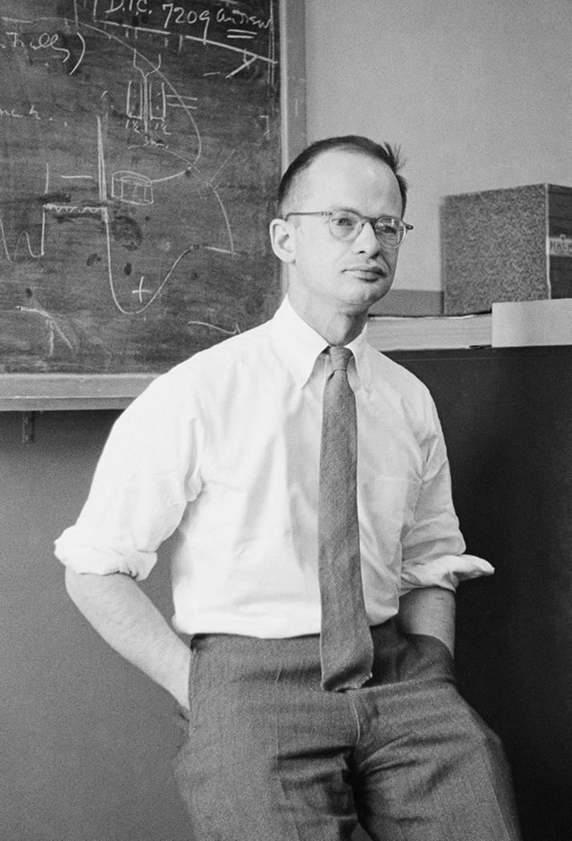
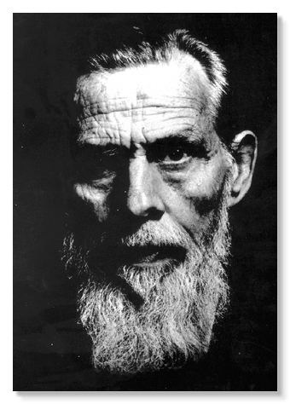
Computational science 1950 - 1990
2- Neural networks 1943: (Suanfazu et al., 2021) (Exastax, 2017) (bootcamp.rutgers, 2021)
- The first conceptual model of a neural network was developed by Warren McCulloch and Walter Pitts.
- They present the concept of a neuron in a network activity.
- Every neuron has three functions: input receiving input processing, and output generation.
Warren McCulloch
Walter Pitts

Slide 8
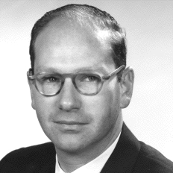
Computational science 1950 - 1990
3- Evolutionary programming 1960:(Suanfazu et al., 2021) (Exastax, 2017) (bootcamp.rutgers, 2021)
- Lawrence J. Fogel founded the Decision Science company for application evolutionary programming in business applications.
- It was the first company that apply evolutionary programming to solve real-world issues.
Lawrence J. Fogel

Slide 9
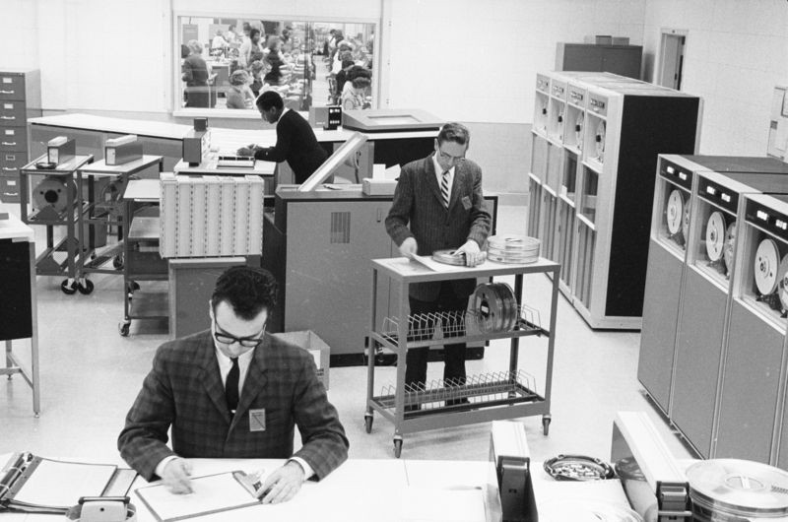
Computational science 1950 - 1990
3- Databases 1970:(Suanfazu et al., 2021) (Exastax, 2017) (bootcamp.rutgers, 2021)
Design an upgraded database management system that can store and retrieve big data sets.

Slide 10
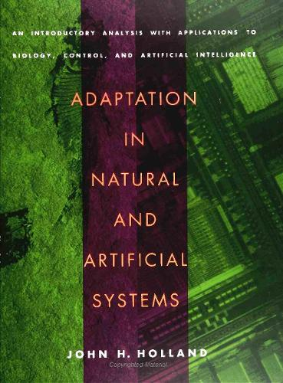
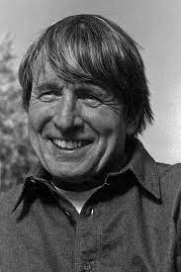
Computational science 1950 - 1990
4- Natural and Artificial Systems 1975:(Suanfazu et al., 2021) (Exastax, 2017) (bootcamp.rutgers, 2021)
- This book was written by John Henry Holland.
- Presents the theoretical basis and analyzes applications.
- The basic study of this book is on genetic algorithms.
John Henry Holland

Slide 11
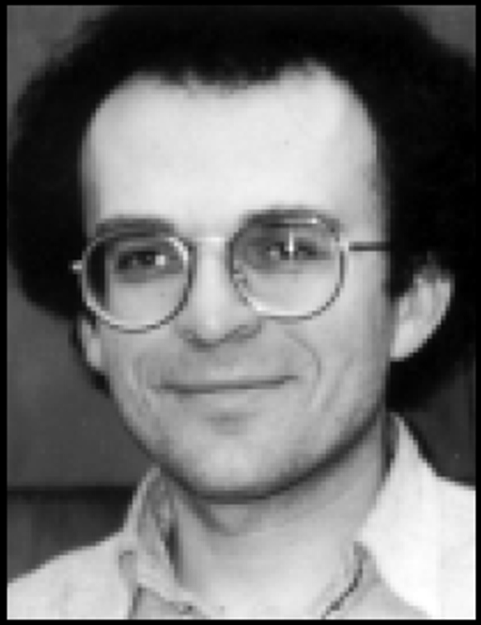
The birth of data mining 1989 - 2007
1- Knowledge Discovery in Databases (KDD) 1989:(Suanfazu et al., 2021) (Exastax, 2017) (bootcamp.rutgers, 2021)
- KDD was created by Gregory Piatetsky-Shapiro, who also arranged the first workshop on the topic.
- This is the first time that data mining has been studied as a separate subject.
-KDD is the whole process and data mining is a part of this process
Gregory Piatetsky-S

Slide 12
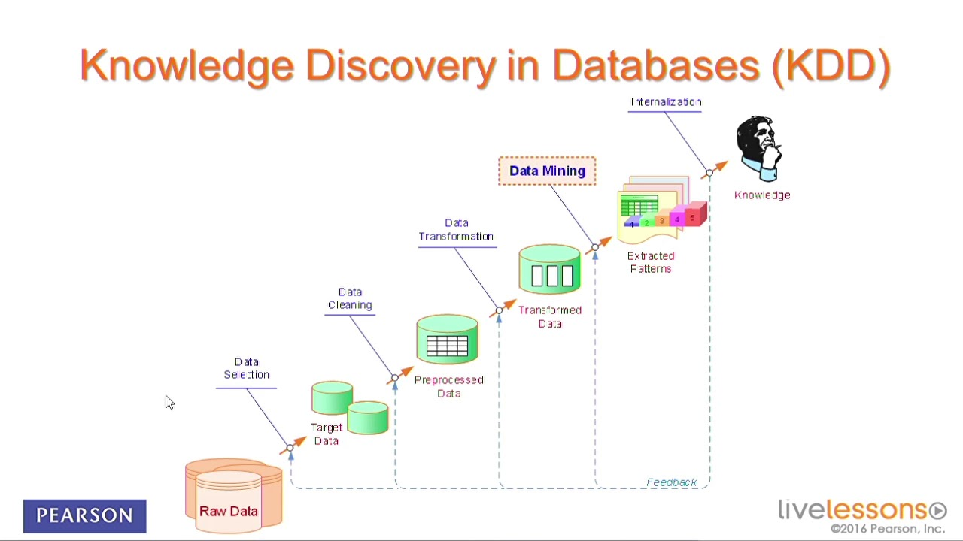
The birth of data mining 1989 - 2007

Slide 13
The birth of data mining 1989 - 2007
2- Support Vector Machines (SVM) 1992:(Suanfazu et al., 2021) (Exastax, 2017) (bootcamp.rutgers, 2021)
The ability to handle complicated data sets greatly improved the capacities of data analysis.
These days, SVMs are an essential tool in data mining, supporting tasks related to regression and classification in the general KDD process.
3- Moneyball Revolution 2003:
-popularized by Michael Lewis' book.
-showed how data mining may be used in baseball team leadership.

Slide 14
Big Data and Data Science2010 - 2022
The concept of Big Data became the center of data mining in 2010.
DJ Patil was chosen as the United States' first Chief Data Scientist in 2015.
Advanced techniques were found like machine learning and natural language (NLP).
Other techniques like Hadoop, and Spark.
In 2018 they gave more attention to data ethics and privacy.
Big growth in IOT and streaming data
(Suanfazu et al., 2021) (Exastax, 2017) (bootcamp.rutgers, 2021)

Slide 15
Theoretical background of data mining
Data mining:
- is the process of filtering through big data sets to find links and patterns that may be used for solving issues.

Slide 16
Theoretical background of data mining
Data mining techniques:
1-Association Rule Mining:
- It is used to find relationships between large data sets, it is usually used in market basket analysis.
2-Classification:
- To classify different data elements to classes, usually used for Email filtering (spam or not spam).
3- Clustering:
-

Slide 17
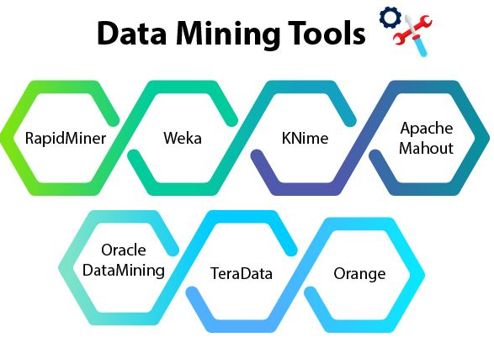
Data mining tools

Slide 18

Data mining tools
1- Rapid Miner: (MonkeyLearn, 2020)
- It is a free open-source platform that has hundreds of algorithms for data preparation such as machine learning, deep learning, text mining, and predictive
- It has pre-build models that allow non-programmers to deal with it easily just by drag and drop.
- Rapid Miner has extensions like R and Python.
- This tool has employees that are ready to help users at any time.
- Using the free plan you can analyze up to 10,000 rows of data.

Slide 19

Data mining tools
2- IBM SPSS Modeler: (MonkeyLearn, 2020)
- This tool allows for data preparation, statistical analysis, and predictive modeling.
- It is also so helpful to people who have no programming skills because it also allows the drag-and-drop feature
- It can handle a big data set from different sources such as Excel, SQL databases, etc...
- The standard version of this tool can just deal with numeric data

Slide 20

Data mining tools
3- Weka:(MonkeyLearn, 2020)
- It is an open-source software, and it has a big collection of algorithms for data mining.
- It is written in JavaScript language.
- This tool has built-in machine-learning models so you don’t need to waste time writing code

Slide 21

Data mining tools
4- Orange:(MonkeyLearn, 2020)
- This tool provides data visualization, Machine learning, Data mining
- All these without having programming skills. (everything is drag and drop)
- It supports various formats such as CSV, Excel, and Database.
- It has a lot of visualization graphs and also by dragging the widget you can use it
- It has Additional categories such as image mining and text mining
- it also supports models for supervised and unsupervised data.

Slide 22
Data mining tools
Tools | Rapid Miner | IBM SPSS Modeler | Weka | Orange
Best Suited For | Data Processing and Analytics | Advanced Users | Machine Learning | Beginners
Strengths | Complex data | Advanced statistical analysis, predictive modeling | Suitable for educational purposes | User-friendly, focused on data visualization
Pricing | Free basic version, paid enterprise | Primarily paid, costly | Free and open-source | Free and open-source
(MonkeyLearn, 2020)

Slide 23
Organization

Slide 24
Organization Information
Organization information
Contact person information

Slide 25
Traditional and modern approaches

Slide 26
Building blocks of Traditional Approach

Slide 27
Building blocks of Modern Approach

Slide 28
Benefits

Slide 29

Text Mining

Slide 30
What is Text Mining?
It is the procedure for converting unstructured text into a format that is structured to find new and significant patterns.
Data mining is an automated process.
Data mining uses Natural Language Processing (NLP) so the machine can understand what human means
Companies can explore and discover hidden relationships
within their unstructured data by using advanced analytical
techniques such as Naive Bayes, Support Vector Machines
(SVM), and other deep learning algorithms.

Slide 31
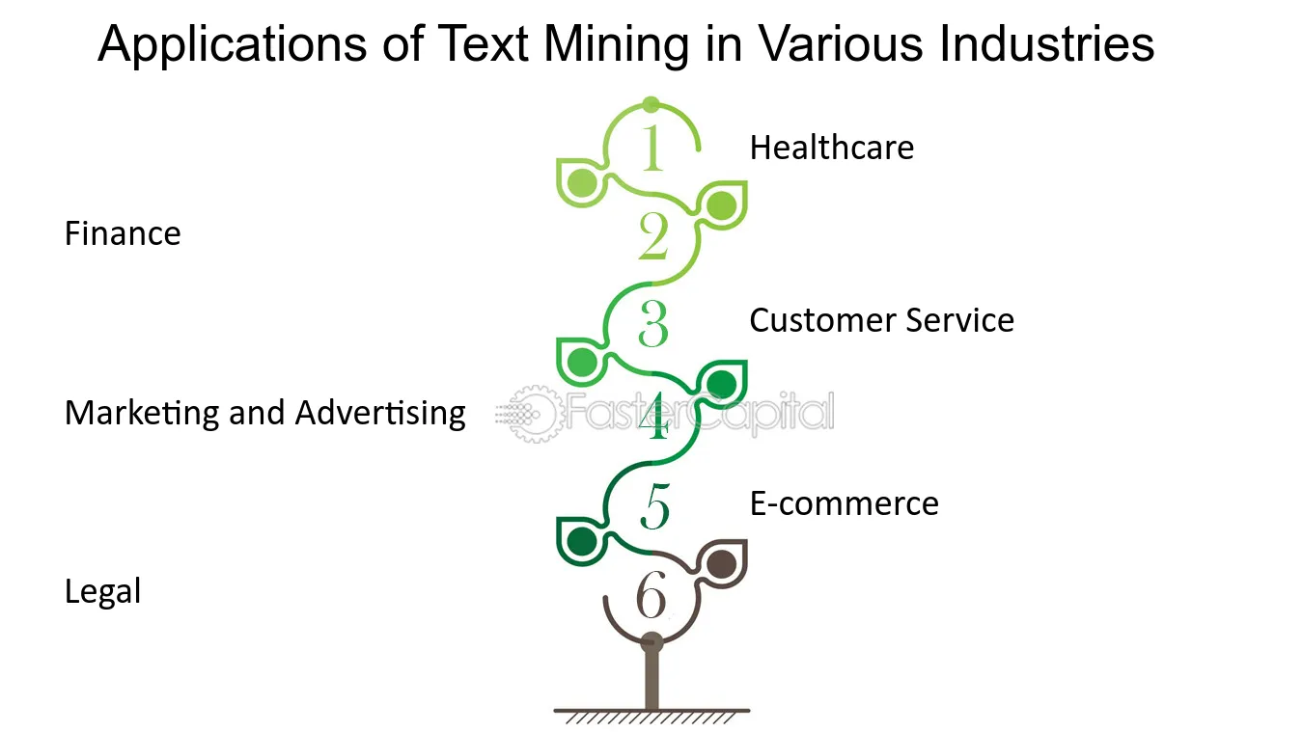
Examples

Slide 32
Real-life examples
Healthcare:(IBM, 2021)
- Using text mining on patient medical information allows doctors to find patterns and relationships in patient symptoms and treatment
- which allows doctors to predict diseases by common symptoms between patients.
Customer serves:(IBM, 2021)
- Using text mining on a library website, allows customers to know what this library has books about the needed topic just by searching for a specific topic while customers at home
Risk management:(IBM, 2021)
- Text mining for carefully examining contracts and legal documents to make sure they conform to laws and regulations.

Slide 33
Text mining tools that are used each sector
(IBM, 2021)
Sectors | Tools | Describtion
Healthcare | cTAKES | created to extract data from electronic medical records.
 | BioBERT | It is a biomedical text mining program based on BERT, specifically for medical research documents.
Customer service | RapidMiner | Have the ability to analyze data about interactions with customers.
 | Dialogflow (Google) | AI technology to translate client queries to help chatbot conversations.
Risk management | SAS Text miner | Focus on identifying fraud and tracking compliance.

Slide 34
Algorithms that are used for text mining.
Naive Bayes Classifier: (Valcheva, 2020) (GeeksforGeeks, 2023)
- It is utilized to divide text into several classes according to probability.
EX: https://www.geeksforgeeks.org/naive-bayes-classifiers/
Support Vector Machines (SVM): (Valcheva, 2020)
- It is the most accurate classification algorithm for text mining
- It is useful for finding outliers and problems such as detecting spam.
- Two data sets are sorted using SVM based on similar grouping.
- Hyperplanes line which separates the groups based on patterns.

Slide 35
Text mining techniques
Information Extraction (IE): (Tyagi, 2022)
- I divide text into tokens and take just the important words.
- it just works with names.
IE task:
- Feature selection -> Feature extraction -> Named entity recognition
- It extracts entities from the text and analyzes their relationships.
Note:
- it evaluates the outcome using precision and recall

Slide 36
Text mining techniques
Text classification: (Tyagi, 2022)
There are many forms of text classification:
1- Topic Analysis:
- It finds the main topic in a document and helps in subject-based data organization.
2-Sentiment Analysis:
- Classifies text as positive, negative, or neutral based on the emotional tone of the text in order to determine opinions.
3-Language Detection:
identifies a text's language, making it possible to efficiently classify and route customer support questions to employees who are familiar with this language,

Slide 37
methods and approaches

Slide 38
TF-IDF
What is TF?
- It shows the number of repetitions of each word in each document, divided by the total number of words in that document
What is IDF?
- This calculates the frequency of each word throughout all documents.
What is TF-IDF?
- it gives each word a weight that shows the importance of the word in each document.

Slide 39
TF-IDF in my code
Steps:
1- I have Imported TfidfVectorizer from sklearn.feature_extraction.text.
2- I created an object called vectorizer from the TfidfVectorizer class, this object will calculate TF-IDF.
3-
4-

Slide 40
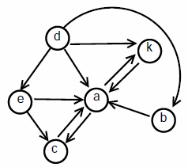
Graph Mining

Slide 41
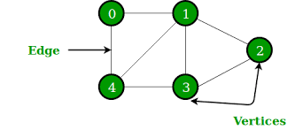
What is Graph Mining?
Graph mining is a way to extract useful information and patterns from graphs
The graph is usually made of nodes and edges.
The graph could be directed or not directed based on the scenario
Graphs are usually used to show complex networks such as social networks, and communication networks
(Xi'an University, 2018)

Slide 42
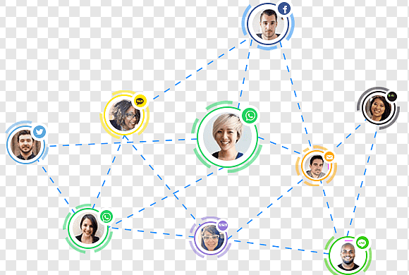
Real-life examples
Social networks: (Xi'an University, 2018)
- Examining the relationships between users on social media sites like Facebook or LinkedIn in order to suggest new friends

Slide 43

Real-life examples
Healthcare:(Xi'an University, 2018)
- Mapping and examining how illnesses travel throughout populations in order to manage growing routes like what happened in Covid 19
- Health organizations worldwide used graph mining to track the spread of the infection.
- Because of this step they knew What populations were most at risk for exposure and where to put resources.

Slide 44

Real-life examples
Transportation and Logistics:(Xi'an University, 2018)
- Decreasing travel times and expenses by evaluating road and airline networks to find the best routes like UPS delivery company
-UPS company used an advanced graph mining algorithm to make their work more professional
- This system is known as On-Road Integrated Optimization and Navigation (ORION).
- This advanced system shows how much left turns, traffic conditions, climate, and even the amount of time needed to open and close car doors and walk to the customer door.

Slide 45
How graph mining algorithms work?

Slide 46
Programming languages used for graph mining:
Python:
- it is used because this language has a lot of libraries for graph mining such as NetworkX, Graph-tool, and PyGraphviz.
Java:
- It is used because of its performance and because it can handle huge graphs, also it has helpful libraries such as JGraphT and Apache Giraph.
R:
- It is used because it provides a full environment for statistical analysis, also it has helpful libraries such as statnet and igraph.

Slide 47

Graph mining tools used in industry
Cytoscape:(M. Vedanayaki, 2014)
- It is used in healthcare sectors, especially in Biomedical research.
- using this tool in this field was helpful for understanding how genes and proteins interact in biology.
- The base language of this tool is Java.

Slide 48

Graph mining tools used in industry
NetworkX:(M. Vedanayaki, 2014)
- it is a Python package.
- it is used in the Academia, Transportation, and Telecommunications sectors.
- it provides different types of graphs such as (simple graphs, directed graphs, and graphs with parallel edges and self-loops)

Slide 49
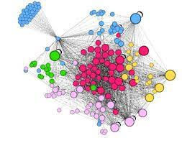
Graph mining tools used in industry
Gephi:(M. Vedanayaki, 2014)
- It is used in the Social Science and marketing sectors.
- It is an open-source software.
- It is used for analyzing all kinds of complex networks.
- The base language of this tool is Java.

Slide 50
Your Application

Slide 52
References
Suanfazu et al. (2021) History of data mining, Hacker Bits. Available at: https://hackerbits.com/data/history-of-data-mining/ (Accessed: 30 November 2023).
bootcamp.rutgers (2021) What is data mining? A beginner’s guide (2022), Rutgers Bootcamps. Available at: https://bootcamp.rutgers.edu/blog/what-is-data-mining/#:~:text=History%20of%20Data%20Mining,-Did%20you%20know&text=Through%20the%20Turing%20Universal%20Machine,what%20data%20mining%20is%20today. (Accessed: 30 November 2023).
Exastax (2017) The history of Data Mining, Medium. Available at: https://medium.com/@exastax/the-history-of-data-mining-d2aeb0f587ce (Accessed: 30 November 2023).
MonkeyLearn (2020) 10 Best Data Mining Tools in 2022, MonkeyLearn Blog. Available at: https://monkeylearn.com/blog/data-mining-tools/ (Accessed: 05 December 2023).
IBM (2021) What is text mining?, IBM. Available at: https://www.ibm.com/topics/text-mining (Accessed: 05 December 2023).
Xi’an University (2018) ITU Workshop on ‘economic and fiscal incentives to accelerate digital transformation of data and applications over telecommunication infrastructure’, ITU. Available at: https://www.itu.int/en/ITU-T/Workshops-and-Seminars/2022/1103/Pages/default.aspx (Accessed: 05 December 2023).
Valcheva, S. (2020) Text mining algorithms list: Text classification categorization clustering, Blog For Data-Driven Business. Available at: https://www.intellspot.com/text-mining-algorithms/ (Accessed: 05 December 2023).
GeeksforGeeks (2023) Naive Bayes classifiers, GeeksforGeeks. Available at: https://www.geeksforgeeks.org/naive-bayes-classifiers/ (Accessed: 05 December 2023).

Slide 53
Tyagi, N. (2022) 7 text mining techniques: Analytics steps, 7 Text Mining Techniques | Analytics Steps. Available at: https://www.analyticssteps.com/blogs/top-7-text-mining-techniques (Accessed: 05 December 2023).
M. Vedanayaki (2014) Indian Journal of Science and Technology, Consequence of Cross Cultural ... Available at: https://sciresol.s3.us-east-2.amazonaws.com/IJST/Articles/2014/Issue-Supplementary-7/Article2.pdf (Accessed: 05 December 2023).

